Slide 1



Windows Functions

Slide 2
What Are Window Functions in MySQL?
An SQL window function performs calculations across a set of table rows that are related to the current row.
This set of rows is called a window or a window frame – that's where the term "window functions" comes from.
Window functions are particularly useful when you need to perform calculations that involve aggregations, rankings, or comparisons within a subset of rows defined by specific criteria.
OVER clause is used with window functions to define that window. OVER clause does two things :
  Partitions rows into form set of rows. (PARTITION BY clause is used)
  Orders rows within those partitions into a particular order. (ORDER BY clause is used)

Slide 3
Note:-
window functions are performed on the result set after all JOIN, WHERE, GROUP BY, and HAVING clauses and before the ORDER BY, LIMIT and SELECT DISTINCT.
If partitions aren’t done, then ORDER BY orders all rows of table.

Slide 4
The general syntax of calling a window function is as follows:
window_function_name(expression) OVER (
[PARTITION BY column1, column2, ...]
[ORDER BY column3 [ASC|DESC], column4 [ASC|DESC], ...]
[ROWS | RANGE frame_definition]
)

Slide 5
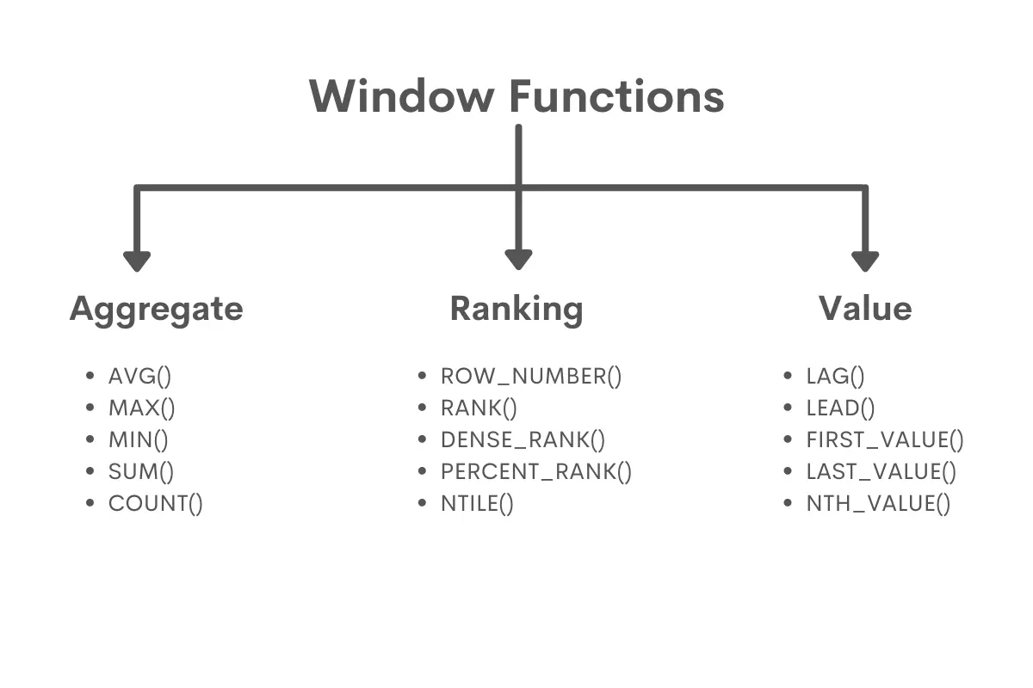
Types of Windows Functions:-

